Slide 1
Lecture 30

Slide 2
END

Slide 4
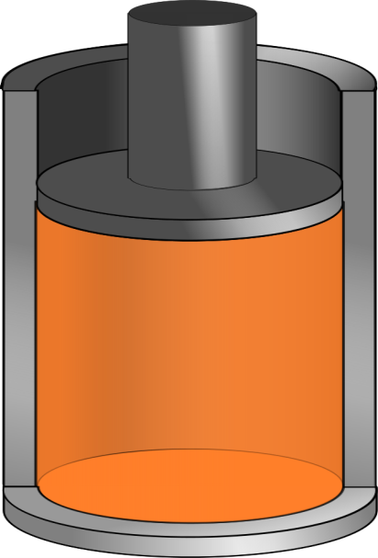

Q negative
Q positive

Slide 5
Question 123.11.3
You increase the temperature of a gas in a piston. Is there heat involved?
Yes
No
Maybe

Slide 6
Question 123.11.6
Which graph represents an isothermal process?
A B C

Slide 7
300K
100K

Slide 8
300K
100K

Slide 9
Warmer
Cooler

Slide 10
Question 123.11.4
You put a gas in a piston through a process that changes the temperature. Can Q=0?
Yes, if it is the right process
No
Maybe

Slide 11
Question 123.11.5
Which quantity is independent of path
Q
ΔE_{int}
W
Can’t tell

Slide 12
Phase Changes
A phase change occurs when the physical characteristics of the substance change from one form to another
Common phases changes are
Solid to liquid – melting
Liquid to gas – boiling
Phases changes involve a change in the internal energy, but no change in temperature

Slide 13
Latent Heat
During a phase change, the amount of heat is given as
Q = ±m L
L is the latent heat of the substance
Latent means hidden
L depends on the substance and the nature of the phase change
Choose a positive sign if you are adding energy to the system and a negative sign if energy is being removed from the system

Slide 14
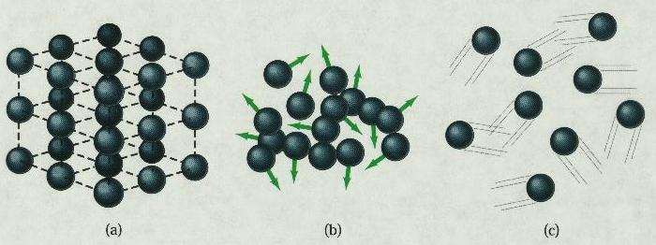
Phase Changes Latent Heat
Solid
Liquid
Gas
During a phase change, the internal energy changes but the temperature does not change.
Work is done against the attractive molecular forces to separate them.

Slide 15
Latent Heat, cont.
SI units of latent heat are J / kg
Latent heat of fusion, L_{f}, is used for melting or freezing
Latent heat of vaporization, L_{v}, is used for boiling or condensing
Table 11.2 gives the latent heats for various substances

Slide 16
Sublimation
Some substances will go directly from solid to gaseous phase
Without passing through the liquid phase
This process is called sublimation
There will be a latent heat of sublimation associated with this phase change

Slide 17
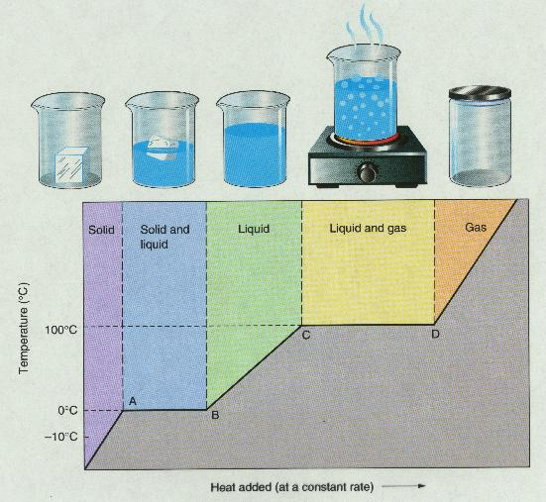
T vs. Q Graphs

Slide 18
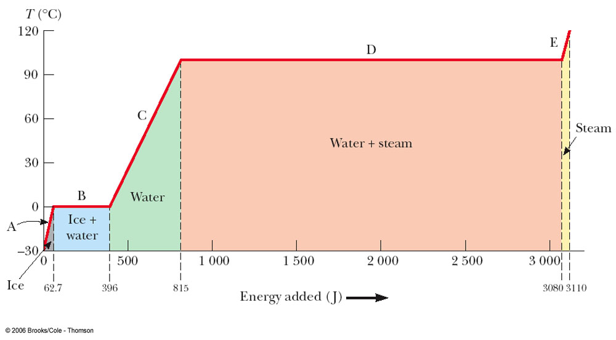
Graph of Ice to Steam

Slide 19
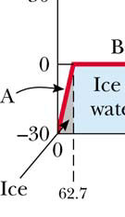
Warming Ice
Start with one gram of ice at –30.0º C
During A, the temperature of the ice changes from –30.0º C to 0º C
Use Q = m c ΔT
Will add 62.7 J of energy

Slide 20
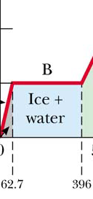
Melting Ice
Once at 0º C, the phase change (melting) starts
The temperature stays the same although energy is still being added
Use Q = m L_{f}
Needs 333 J of energy

Slide 21
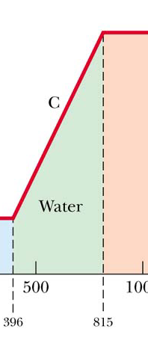
Warming Water
Between 0º C and 100º C, the material is liquid and no phase changes take place
Energy added increases the temperature
Use Q = m c ΔT
419 J of energy are added

Slide 22
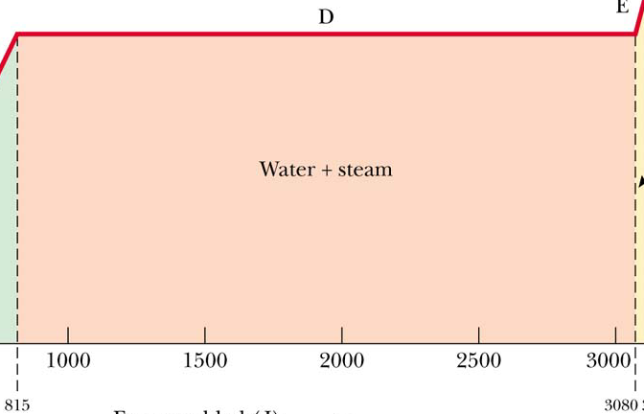
Boiling Water
At 100º C, a phase change occurs (boiling)
Temperature does not change
Use Q = m Lv
2 260 J of energy are needed

Slide 23
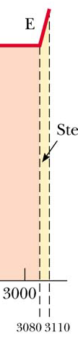
Heating Steam
After all the water is converted to steam, the steam will heat up
No phase change occurs
The added energy goes to increasing the temperature
Use Q = m c ΔT
To raise the temperature of the steam to 120°, 40.2 J of energy are needed

Slide 24
Problem Solving Strategies
Make a table
A column for each quantity
A row for each phase and/or phase change
Use a final column for the combination of quantities
Use consistent units

Slide 25
Problem Solving Strategies, cont
Apply Conservation of Energy
Transfers in energy are given as Q=mcΔT for processes with no phase changes
Use Q = m L_{f} or Q = m L_{v} if there is a phase change
In Q_{cold} = - Q_{hot} be careful of sign
ΔT is T_{f} – T_{i}
Solve for the unknown

Slide 26
20.4 Work and Heat in Thermodynamic Processes

Slide 27

Work in a Gas Cylinder
The gas is contained in a cylinder with a moveable piston
The gas occupies a volume V and exerts pressure P on the walls of the cylinder and on the piston

Slide 28
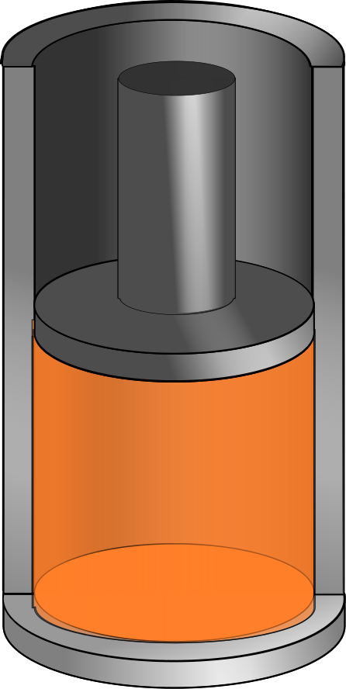
Work in a Gas Cylinder, cont.
A force is applied to slowly compress the gas
The compression is slow enough for all the system to remain essentially in thermal equilibrium
W = - P ΔV
This is the work done on the gas
Δy

Slide 29
More about Work on a Gas Cylinder
When the gas is compressed
ΔV is negative
The work done on the gas is positive
When the gas is allowed to expand
ΔV is positive
The work done on the gas is negative
When the volume remains constant
No work is done on the gas

Slide 30
Notes about the Work Equation
The pressure remains constant during the expansion or compression
This is called an isobaric process
If the pressure changes, the average pressure may be used to estimate the work done

Slide 31
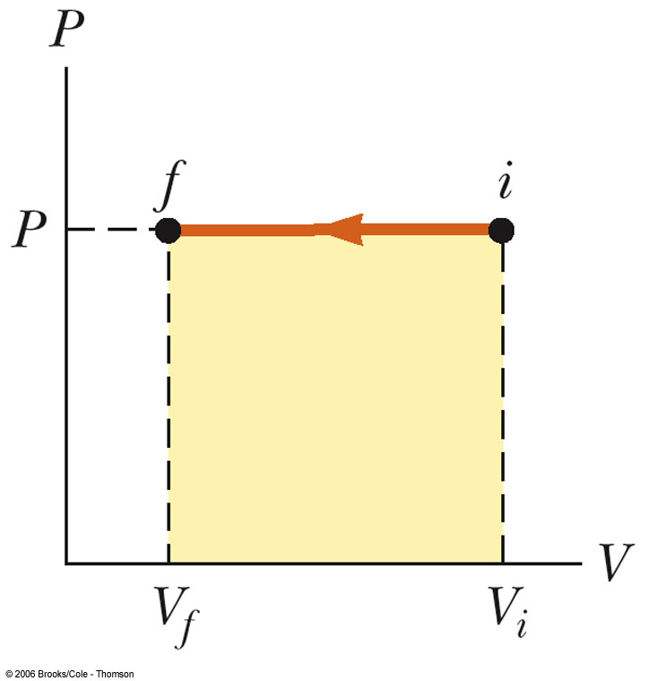
PV Diagrams
Used when the pressure and volume are known at each step of the process
The work done on a gas that takes it from some initial state to some final state is the negative of the area under the curve on the PV diagram
This is true whether or not the pressure stays constant

Slide 32
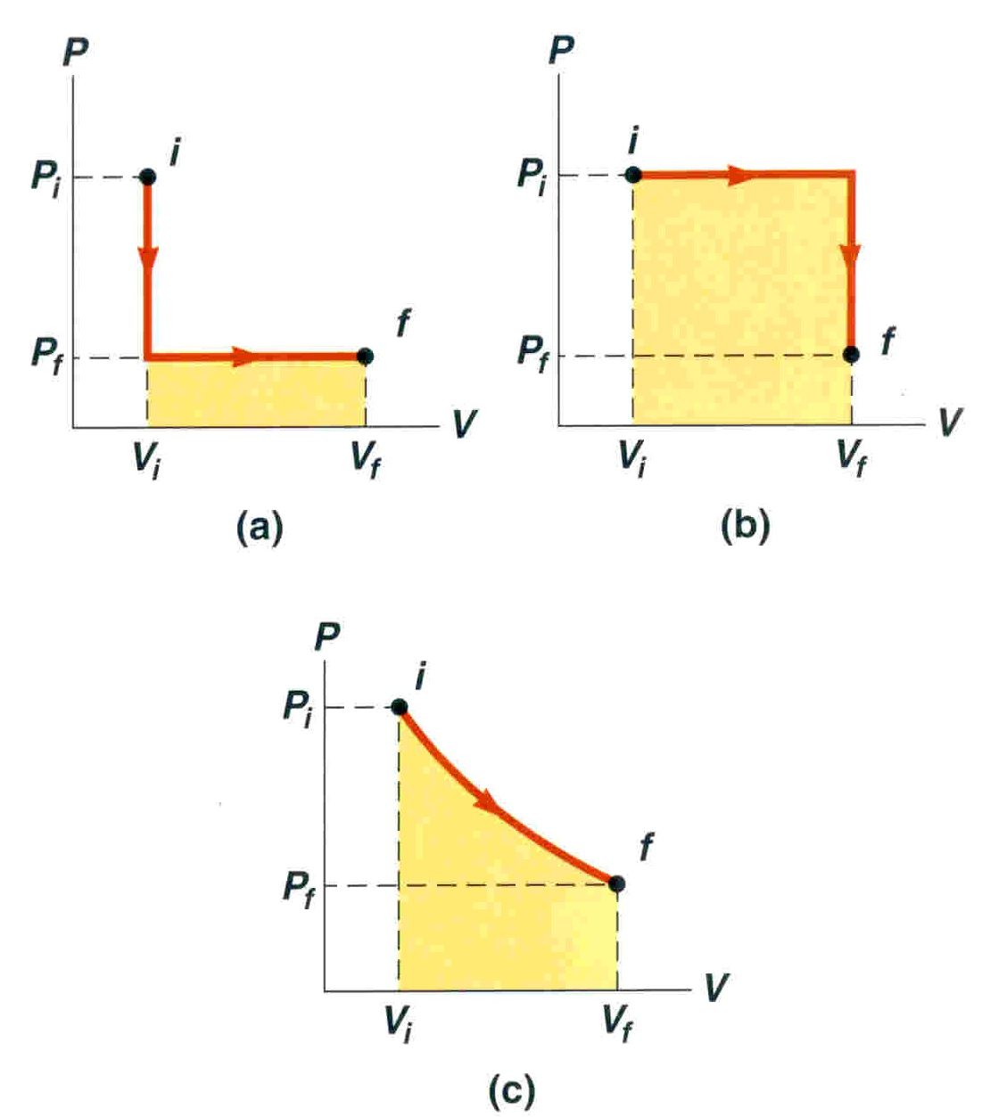
PV Diagrams, cont.
The curve on the diagram is called the path taken between the initial and final states
The work done depends on the particular path
Same initial and final states, but different amounts of work are done

Slide 33
Summary
Specific Heat
Latent Heat

Slide 34
Summary
Work in Thermodynamic Processes
PV diagrams
Problems to try 12-19
W = - P ΔV

Slide 35
End

Slide 36
Molecular Model of an Ideal Gas

Slide 38
Question 123.14.1.5
A car is driving down I-20 at 70mph (the new speed limit). Does the center of mass of the car have the same kinetic energy as a piston in the engine?
Yes
No
Maybe
Wait, the speed limit changed?

Slide 39
Question 123.14.1
We have two gases, each with the same values of n, V and T. One gas is Hydrogen, the other is Nitrogen. For which gas is the rms speed larger?
Hydrogen
Nitrogen

Slide 40
v_{system}
v_{molecule}
V
P
n
T

Slide 42
Question 123.14.2
If the temperature increases, the peak of the Maxwell-Boltzmann speed distribution
Increases to a higher velocity
Decreases to a lower velocity
Stays the same
Can’t tell

Slide 43
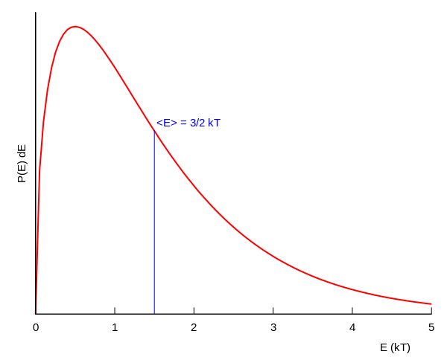
Boltzmann Distribution

Slide 44
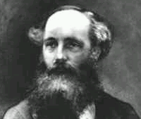
Found an expression for the Molecular Speed Distribution
James Clerk Maxwell (1831-1879)

Slide 45
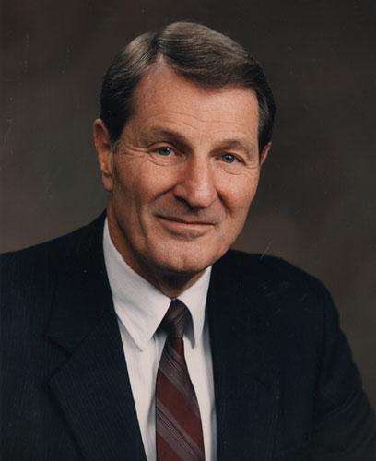
Not the same guy
Neal A. Maxwell
(1926-2004)

Slide 46
N - total number of molecules

Slide 47
Question 123.14.2
If the temperature increases, the peak of the Maxwell-Boltzmann speed distribution
Increases to a higher velocity
Decreases to a lower velocity
Stays the same
Can’t tell

Slide 48
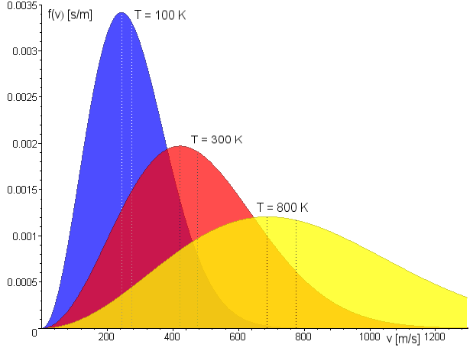
Maxwell Distribution
A system of gas at a given temperature will exhibit a variety of speeds
Three speeds are of interest:
Most probable
Average
rms
Image in the Public Domain couracy Fred Stober

Slide 49
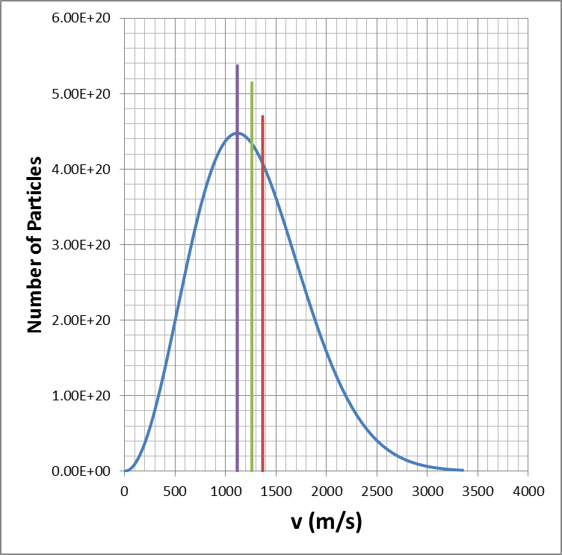
Molecular Speeds

Slide 50
Question 123.14.4
Two gases have the same number of molecules, the same volume, pressure, and temperature. Gas A has molecules that are twice the size of gas B. The mean path of A is
¼ the mean free path of B
½ the mean free path of B
Twice the mean free path of B
4 times the mean free path of B

Slide 51
Mean Free Path
The average distance between collisions. Depends on:
diameter of the molecules
density of gas
Random-walk process

Slide 52
Equivalent Collision
Collision
Equivalent Collision
d
d
d
d

Slide 53
L
2d

Slide 54
Mean Free Path
Collision Frequency
Random-walk process

Slide 55
Mean Free Path
For air molecules at room temperature:
(Molecule separation distance is 3.4x10⁻⁹ m.)

Slide 56
Partial Summary
Mean Free Path
Problems to try 21.45, 21.61
Extra Credit: Write up why the square root of 2 was needed

Slide 57
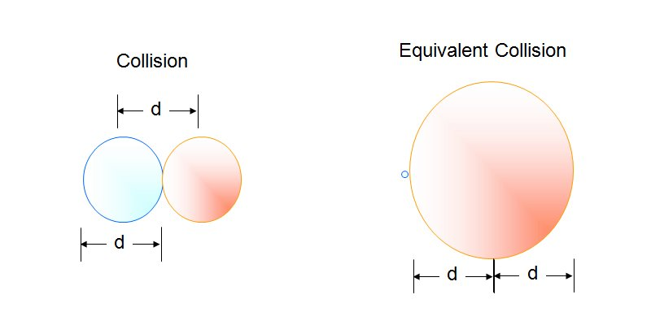

Slide 58
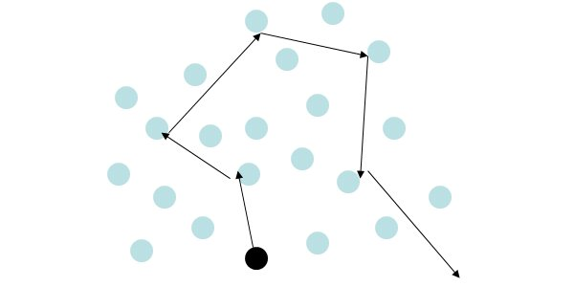

Slide 59
Assumptions
The number of molecules in the gas is large and the average separation between them is large compared to their dimensions
The molecules obey Newton’s laws of motion, but as a whole they move randomly

Slide 60
Assumptions, cont.
The molecules interact only by short-range forces during elastic collisions
The molecules make elastic collisions with the walls
The gas under consideration is a pure substance, all the molecules are identical

Slide 61
Question 123.14.5
A ball bounces off a wall. If the initial velocity of the ball is v_{x} and the final velocity of the ball is –v_{x}, what is the change in momentum of the ball?
mv_{x}
0
-mv_{x}
2mv_{x}
v_{x}
-v_{x}

Slide 62
Particle in a Box
d
v
d
v_{x}

Slide 63
Momentum of the Collision
v_{x}
-v_{x}

Slide 64
Question 123.14.5
A ball bounces off a wall. If the initial velocity of the ball is v_{x} and the final velocity of the ball is –v_{x}, what is the change in momentum of the ball?
mv_{x}
0
-mv_{x}
2mv_{x}
v_{x}
-v_{x}

Slide 65
Average Force and Impulse
F
t
F
F
F
t
t
F
t

Slide 66
Question 123.14.7
What is the name of this quantity?
Kale-Gordon factor
Boltzmann's factor
The average value of x
The standard deviation of x

Slide 67
Question 123.14.8
We learned a name for what is that name?
b)
c)
d) Craig

Slide 68
Some rms Speeds

